Slide 1
PostgreSQL Conference 2009 Japan - JPUG 10th Anniversary Conference -
19th November 2009 - PostgreSQL Cluster Developer meeting
20th November 2009 - PostgreSQL Conference 2009 Japan ( Business Day)
21st November 2009 - PostgreSQL Conference 2009 Japan ( Community Day)
http://www.postgresql.jp/events/pgcon09j/e/pgcon2009j/view

Slide 2
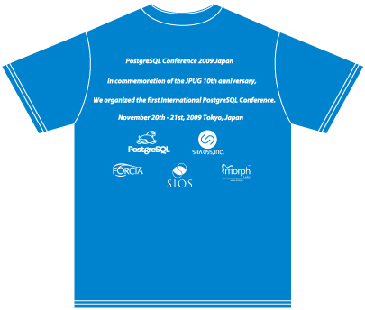
Novelties!

