Slide 1
Amazon RDS for PostgreSQL
Grant McAlister – Senior Principal Engineer
Oct 24, 2014

Slide 2



Amazon Relational Database Service
RDS is a managed Relational database service that is simple to deploy, easy to scale, reliable and cost-effective
Choice of Database Engines
Managed Service
Easy to Scale and Operate
High Performance
High Availability
Amazon Relational Database Service (RDS)

Slide 3
Availability – Read and Write – Multi-AZ
cname update
DNS
Application
Application
Primary Update
Primary
Secondary
Secondary
Primary
AZ1
AZ2
Physical
Synchronous
Replication

Slide 4
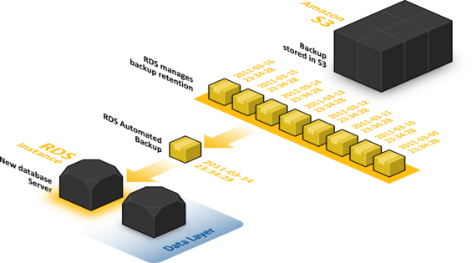
Backups and Disaster Recovery
DB Snapshots
User-driven snapshots of database
Kept until explicitly deleted
Automated Backups
Nightly system snapshots + transaction backup
Enables point-in-time restore to any point in retention period, up to the last 5 minutes
Max retention period = 35 days
Cross region copy
Change regions
Disaster recovery

Slide 5
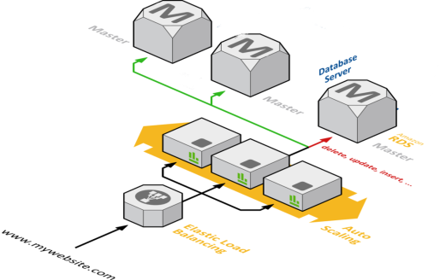
Push Button Scaling
Scale nodes vertically up or down
14 Current Generation DB Instance Classes
db.t2.micro (AWS Free Usage Tier)
db.r3.8xlarge(32 virtual cores, 244GB)
Online Storage Scaling 5GB-3TB
Magnetic & General Purpose SSD
Provisioned IOPS (SSD) up to 30,000
Scale out nodes horizontally
Shard based on data or workload characteristics
Fast and easy database creation

Slide 6
Security
Internet
Application
DB Access & Privileges
DB
Security Group - Network
VPC
IAM

Slide 7
Amazon RDS for PostgreSQL
Database Versions: PostgreSQL 9.3.1, 9.3.2, and 9.3.3
Includes valuable RDS functionality
Fast Deployment
Backups and Point-in-Time-Recovery
Snapshots and Restore
Compute and Storage Scaling
Multi-AZ
Provisioned IOPs

Slide 8
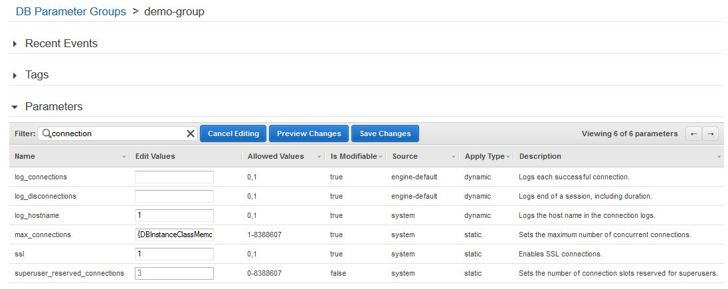
DB Parameter Groups
Filter=“connection”
{DBInstanceClassMemory/12582880}

Slide 9
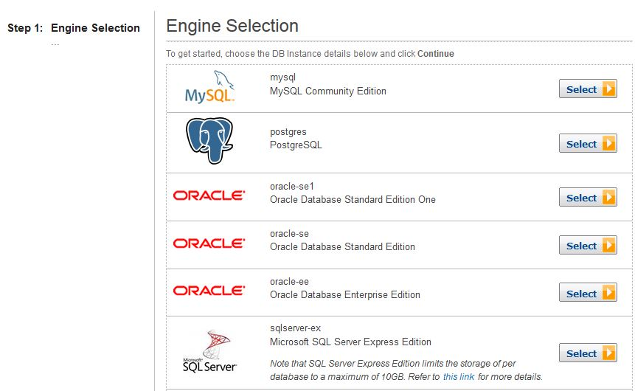
Launching a Postgres DB Instance

Slide 10
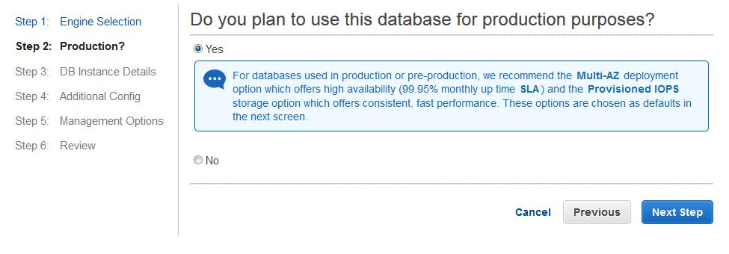
Select Production Use (or not)

Slide 11
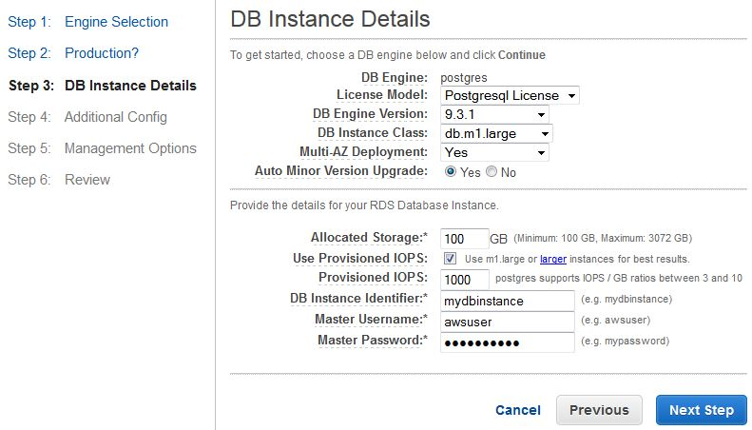
Instance Details

Slide 12
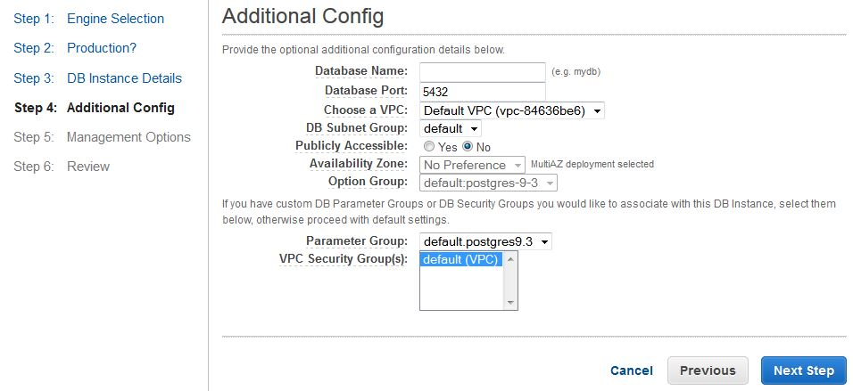
Additional Configuration

Slide 13
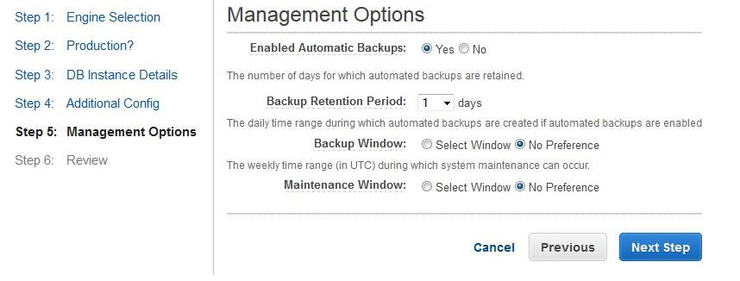
Management Options

Slide 14
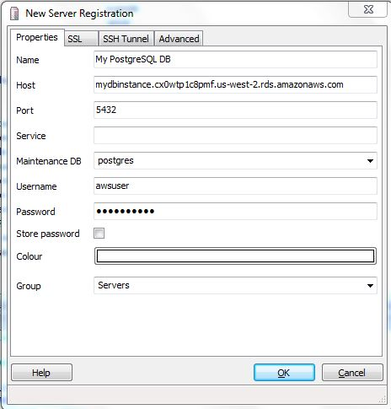
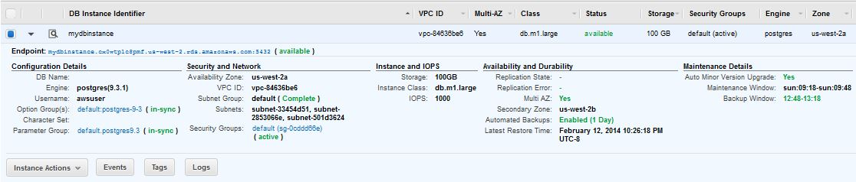
Running Instance

Slide 15
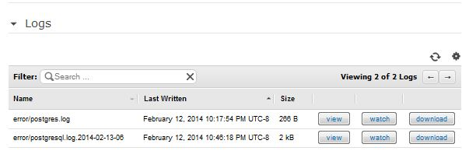
Log File Access

Slide 16
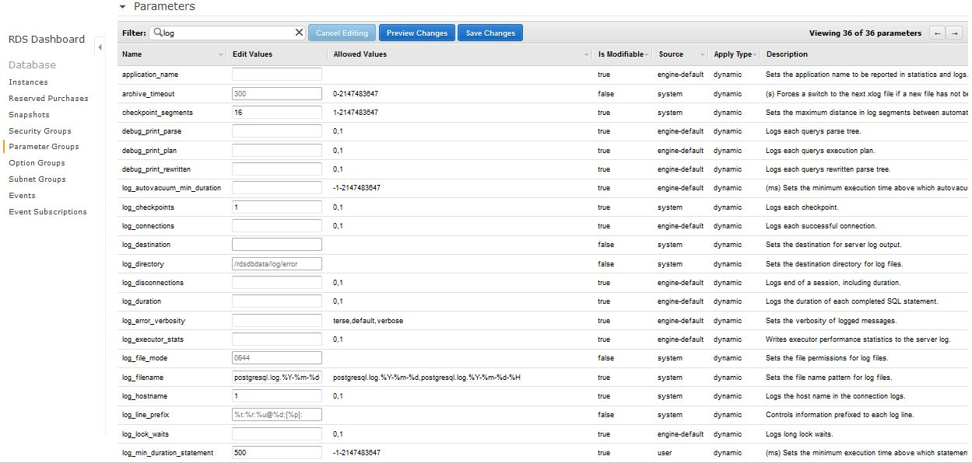
Log Parameters

Slide 17
Log File Access

Slide 18
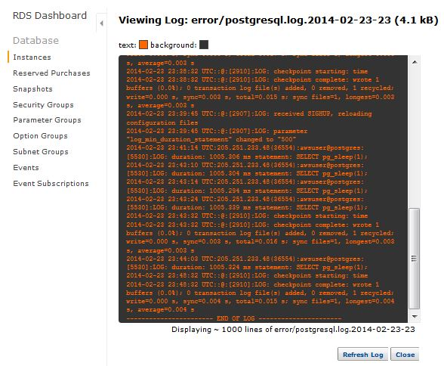
Viewing a Log File
Date Time: SELECT pg_sleep(1);
Date Time: checkpoint starting
Date Time: checkpoint complete: wrote 1 buffers (0.0%); 0 transaction log file(s) added, 0 removed, 1 recycled; write=0.000 s, sync=0.003 s, total=0.016 s; sync files=1, longest=0.003 s, average=0.003 s

Slide 19
Permissions
superuser role (Postgres)
rds_superuser role (RDS provided)
Load and Use Extensions
View and Kill Sessions
Create Tablespace
…

Slide 20

Extensions
PostGIS available
rds.extensions parameter:
btree_gin
btree_gist
chkpass
citext
cube
dblink
dict_int
dict_xsyn
earthdistance
fuzzystrmatch
hstore
intagg
intarray
isn
ltree
pgcrypto
pgrowlocks
pg_trgm
plperl
plpgsql
pltcl
postgis
postgis_tiger_geocoder
postgis_topology
sslinfo
tablefunc
tsearch2
unaccent
uuid-ossp

Slide 21
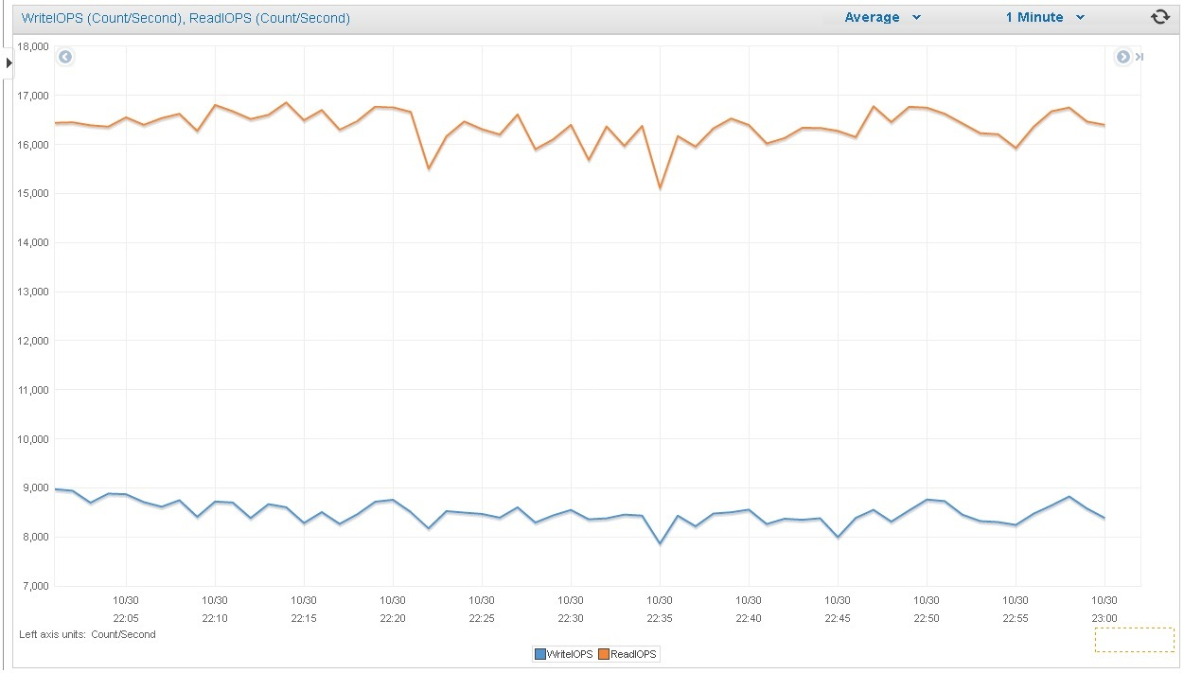
High Performance
16,500+ Read and 8,500+ Write = 25,000+ IOPS

Slide 22
Getting Started
Launch an instance from AWS Console
Configure Network
Load Extensions
Export from existing database using pg_dump
Import to RDS using pg_restore

Slide 23
Learnings from RDS PostgreSQL - Magic Parameters
Example – fsync = 0
Can be dangerous if you don’t understand what won’t be fsync’d (i.e. create extension)
Safer to turn of synchronous_commit
TEST to make sure changing parameters makes sense
Dependent on “YOUR ENVIRONMENT”

Slide 24
104%
<%4

Slide 25
<%3

Slide 28
Thank You
Questions?

